Slide 1




Radiometric Calibration of Earth-observing Satellites
By: Nicolas Iokepa Colon
Mentor: Jeff Czapla-Myers, Ph.D
Key Acknowledgements: The Remote Sensing Group (RSG)
Arizona State University, Tempe, AZ
April 22, 2017

Slide 2
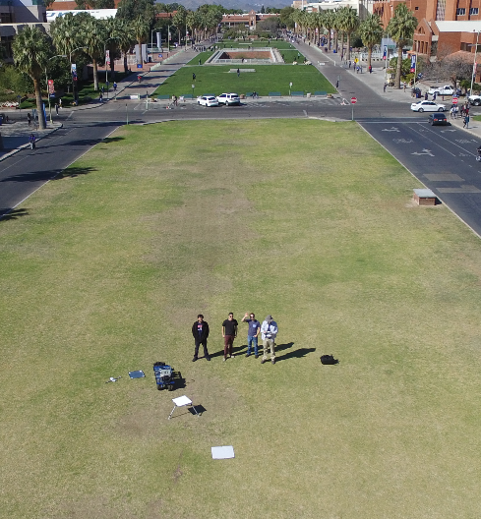
Outline
How we Calibrate (The Problem)
Internship Projects
  MATLAB Data Analysis Code
    Improvements
    Data and Plots
  Shipping Case Design
    Design
    Final Product
Interpretation of Final Results
  Conclusion and Impact

Slide 3
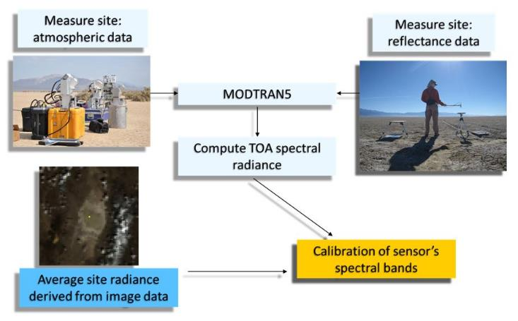
Remote Sensing Group’s Calibration Method
Atmospheric Scattering, Absorption
  Affects Satellite Reflectance readings
Ground-Viewing Radiometers (GVRs)
  Spectralon Panel Calibration → NIST
  Field Site Ground Reflectance
Filters in GVR Calibrated
  Monochromator calibrates
  Specific Bandwidths used
Solar Radiometer
  Atmospheric Scattering
Total Radiative Transfer
Satellite Pass Over
  Comparison
  Radiometric Calibration
Notes:
Maybe skip over the Satellite Pass Over and Solar radiometer/ radiative transfer to save time

Slide 4
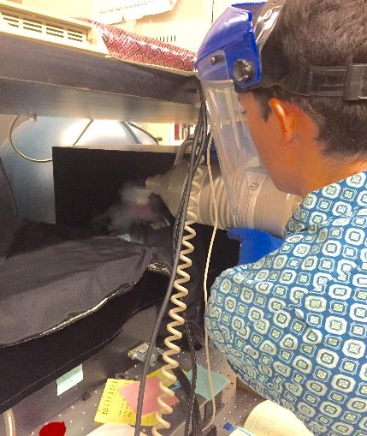
MATLAB Data Analysis Code
Monochromator
  Transmittance
  Calibration & Filter Files
Plots and Final Text file output
Old Data Processing
  IDL programming language
  Calculation Errors
  Graph Generation
Newly Designed Code
  Corrected Calculations
  User Selection Capabilities
  Graphing Versatility
  Calibration Graph → Lamp Analysis
  User Friendly Annotations
Notes:
Errors
Effective Transmittance Calculation sometimes larger than max transmittance
Legend of Data interferes with plotted curve (clarity issue)
Less annotations made code hard to follow
Improvements
Corrected errors in Effective Transmittance Calculations
User able to choose easily the file location and select proper file to run
User able to Name Graph as Desired
Graphs can have colors changed and can have legend moved before finally printing (avoids legend placement errors
Text file produced as well and adds legend for logarithmic file
Calibration File graphed to track Lamp output and ensure quality of lamp

Slide 5
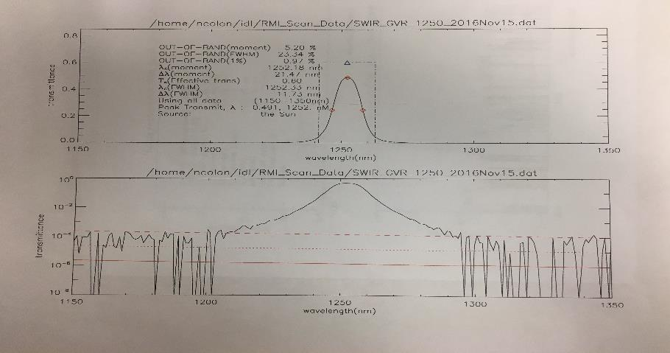
Errors in Graphs from Old Program
Legend Placement Inconvenience
Effective Transmittance Error

Slide 6
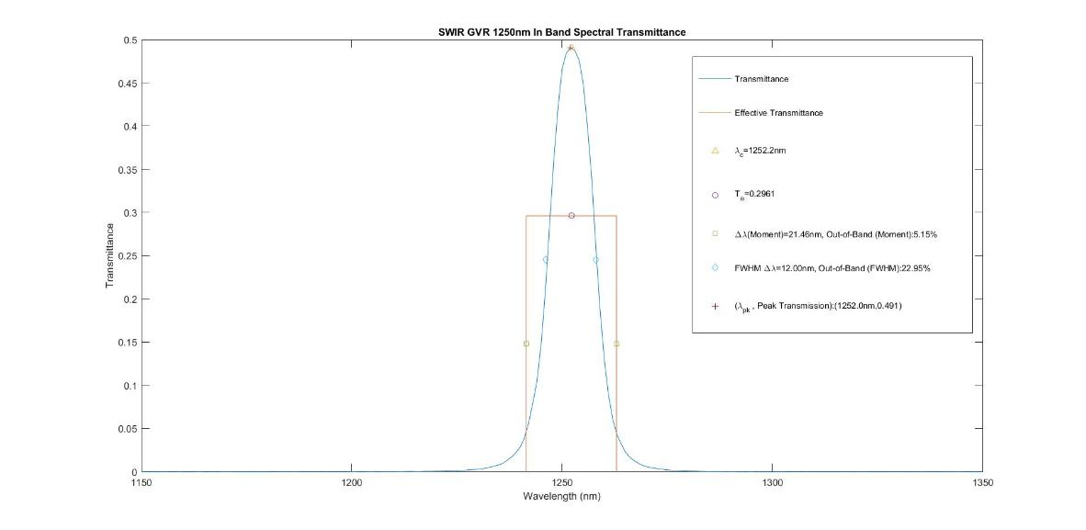
Transmittance
Wavelength (nm)

Slide 7
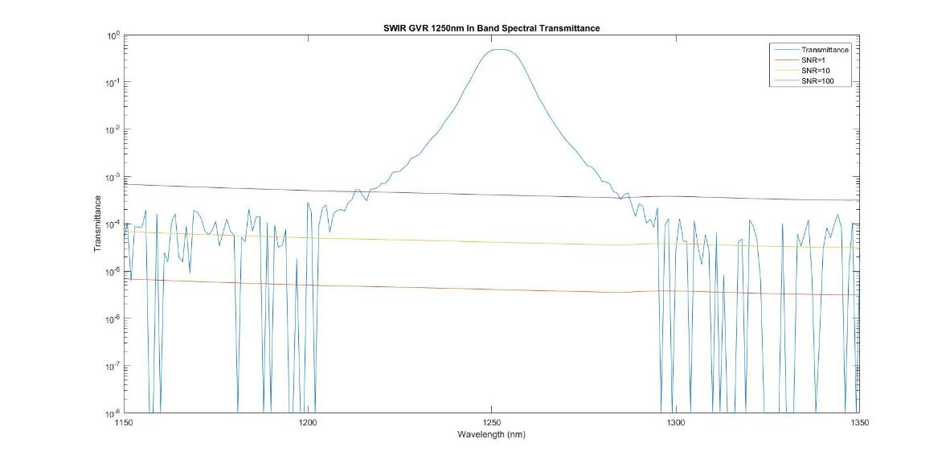
Transmittance
Wavelength (nm)

Slide 8
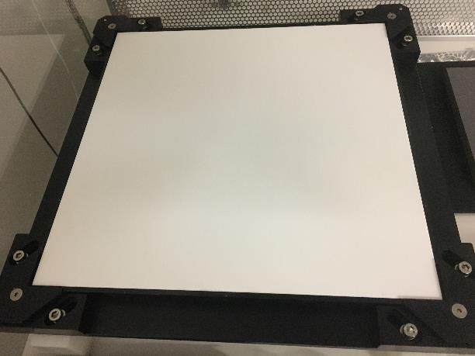
Shipping Case Design
Goal: Protect Calibrated Panel
  Shipping Safety
  Safe Removal
  Before Calibration $250
  After Calibration $30,000
Design Proposal
  Box Profile/Size
  Weather Proof
  6 Degrees of Constraint
  Material Choice

Slide 9
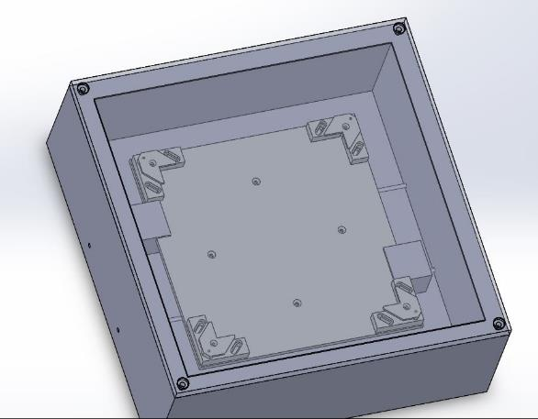
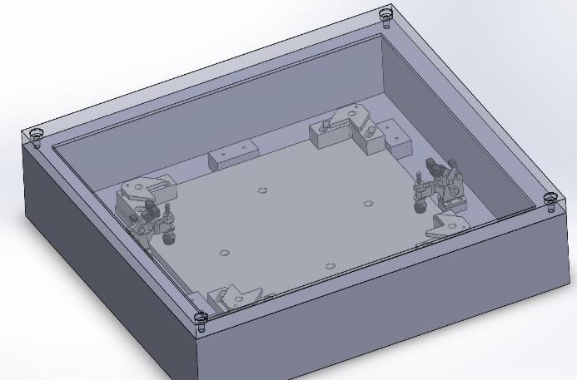
Preliminary Designs
1st Design
→Profile too large
→Poor Holder Stability
2nd Design
→Still too Large
→Difficult Removal

Slide 10
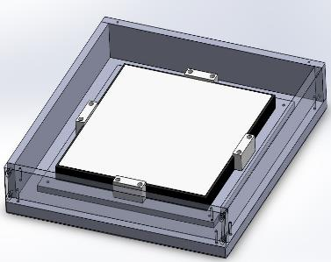
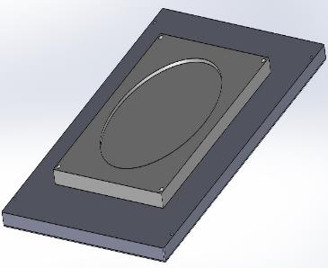
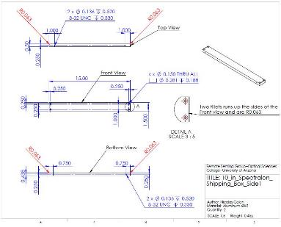
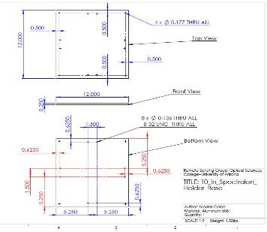
Final Design
Improved Design Approval
  Teflon and Stainless Steel
  Minimal Material
  New Simple Holder
  Smoothed Corners for safe carrying
Final Design Technical Drawings
  Accuracy and Clarity for Machinist
Manufacturing and Final Product
  15” x 15” x 2.5”

Slide 11
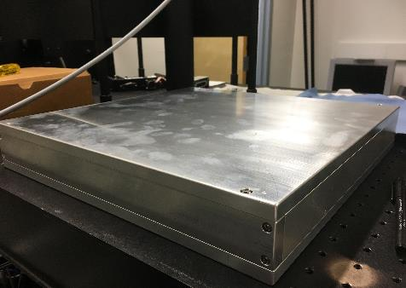
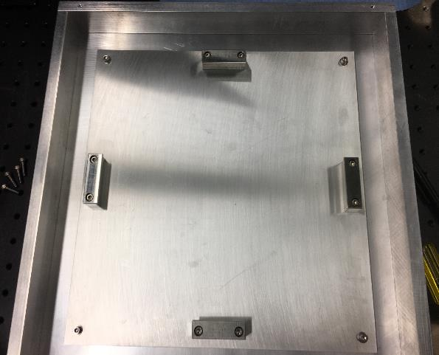
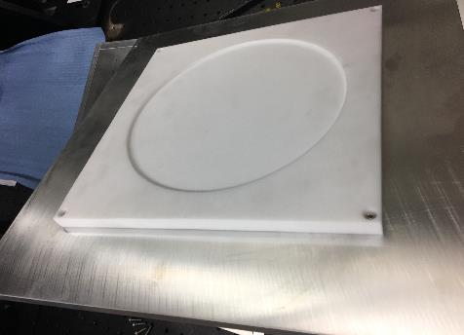
Finished Product

Slide 12
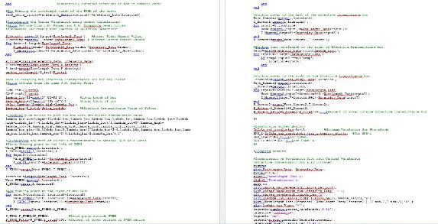
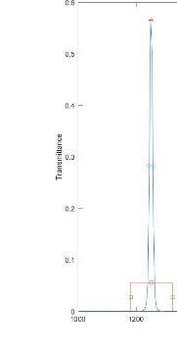
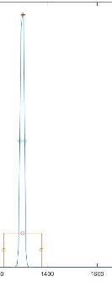

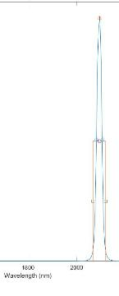
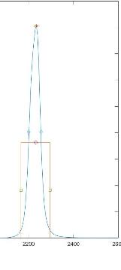
Final Results and Conclusions
Final Products Produced
  Improved MATLAB Code
    Spectral Measurements
    Filter Characterization
    Data Analysis and Graphing
    MATLAB Coding Proficiency
  Protective Shipping Case
    SolidWorks Fluency
    Technical Drawings
    Design Review and Presentation
    Manufacturing Communication
Impacts on Research Group
  User Versatility of Filter Processing Code
  Improved Filter Characterizing
  Safer Panel Transport
Transmittance
Wavelength (nm)

Slide 13
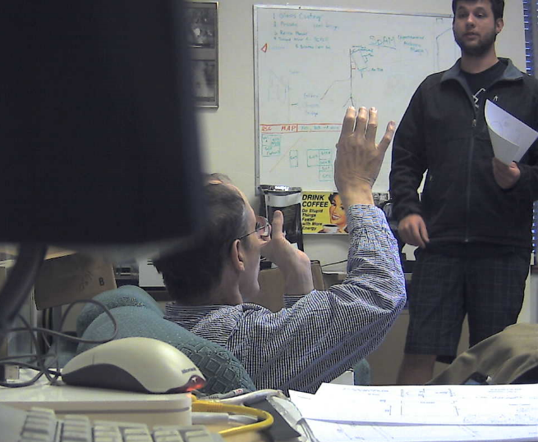
Acknowledgements
Jeff Czapla-Myers
Nik Anderson
Stuart Biggar
Rob Kingston
Roger Tree
Adam Abdelatif
Notes:
Jeff Czapla-Myers (Opening the door for this opportunity, Final Program Advice, Teaching about Radiometry)
Nik Anderson (Mechanical Design Advice and Monochrometer Operation education)
Stuart Biggar (Program Advice, Design Advice)
Rob Kingston (Program Advice)
Roger Tree (Filter Functions and Monochrometer Work)
Adam Abdelatif (Teaching Tricks about MatLab and working together on the Shipping Case Design)

Slide 14
Thank You

